Slide 1


LEGALEASE AI
Karnataka High Court Case Assistant
Presented By:- Kshiti, Brunda , Raju , Bindushree, Jaromi , Mujeeb

Slide 2

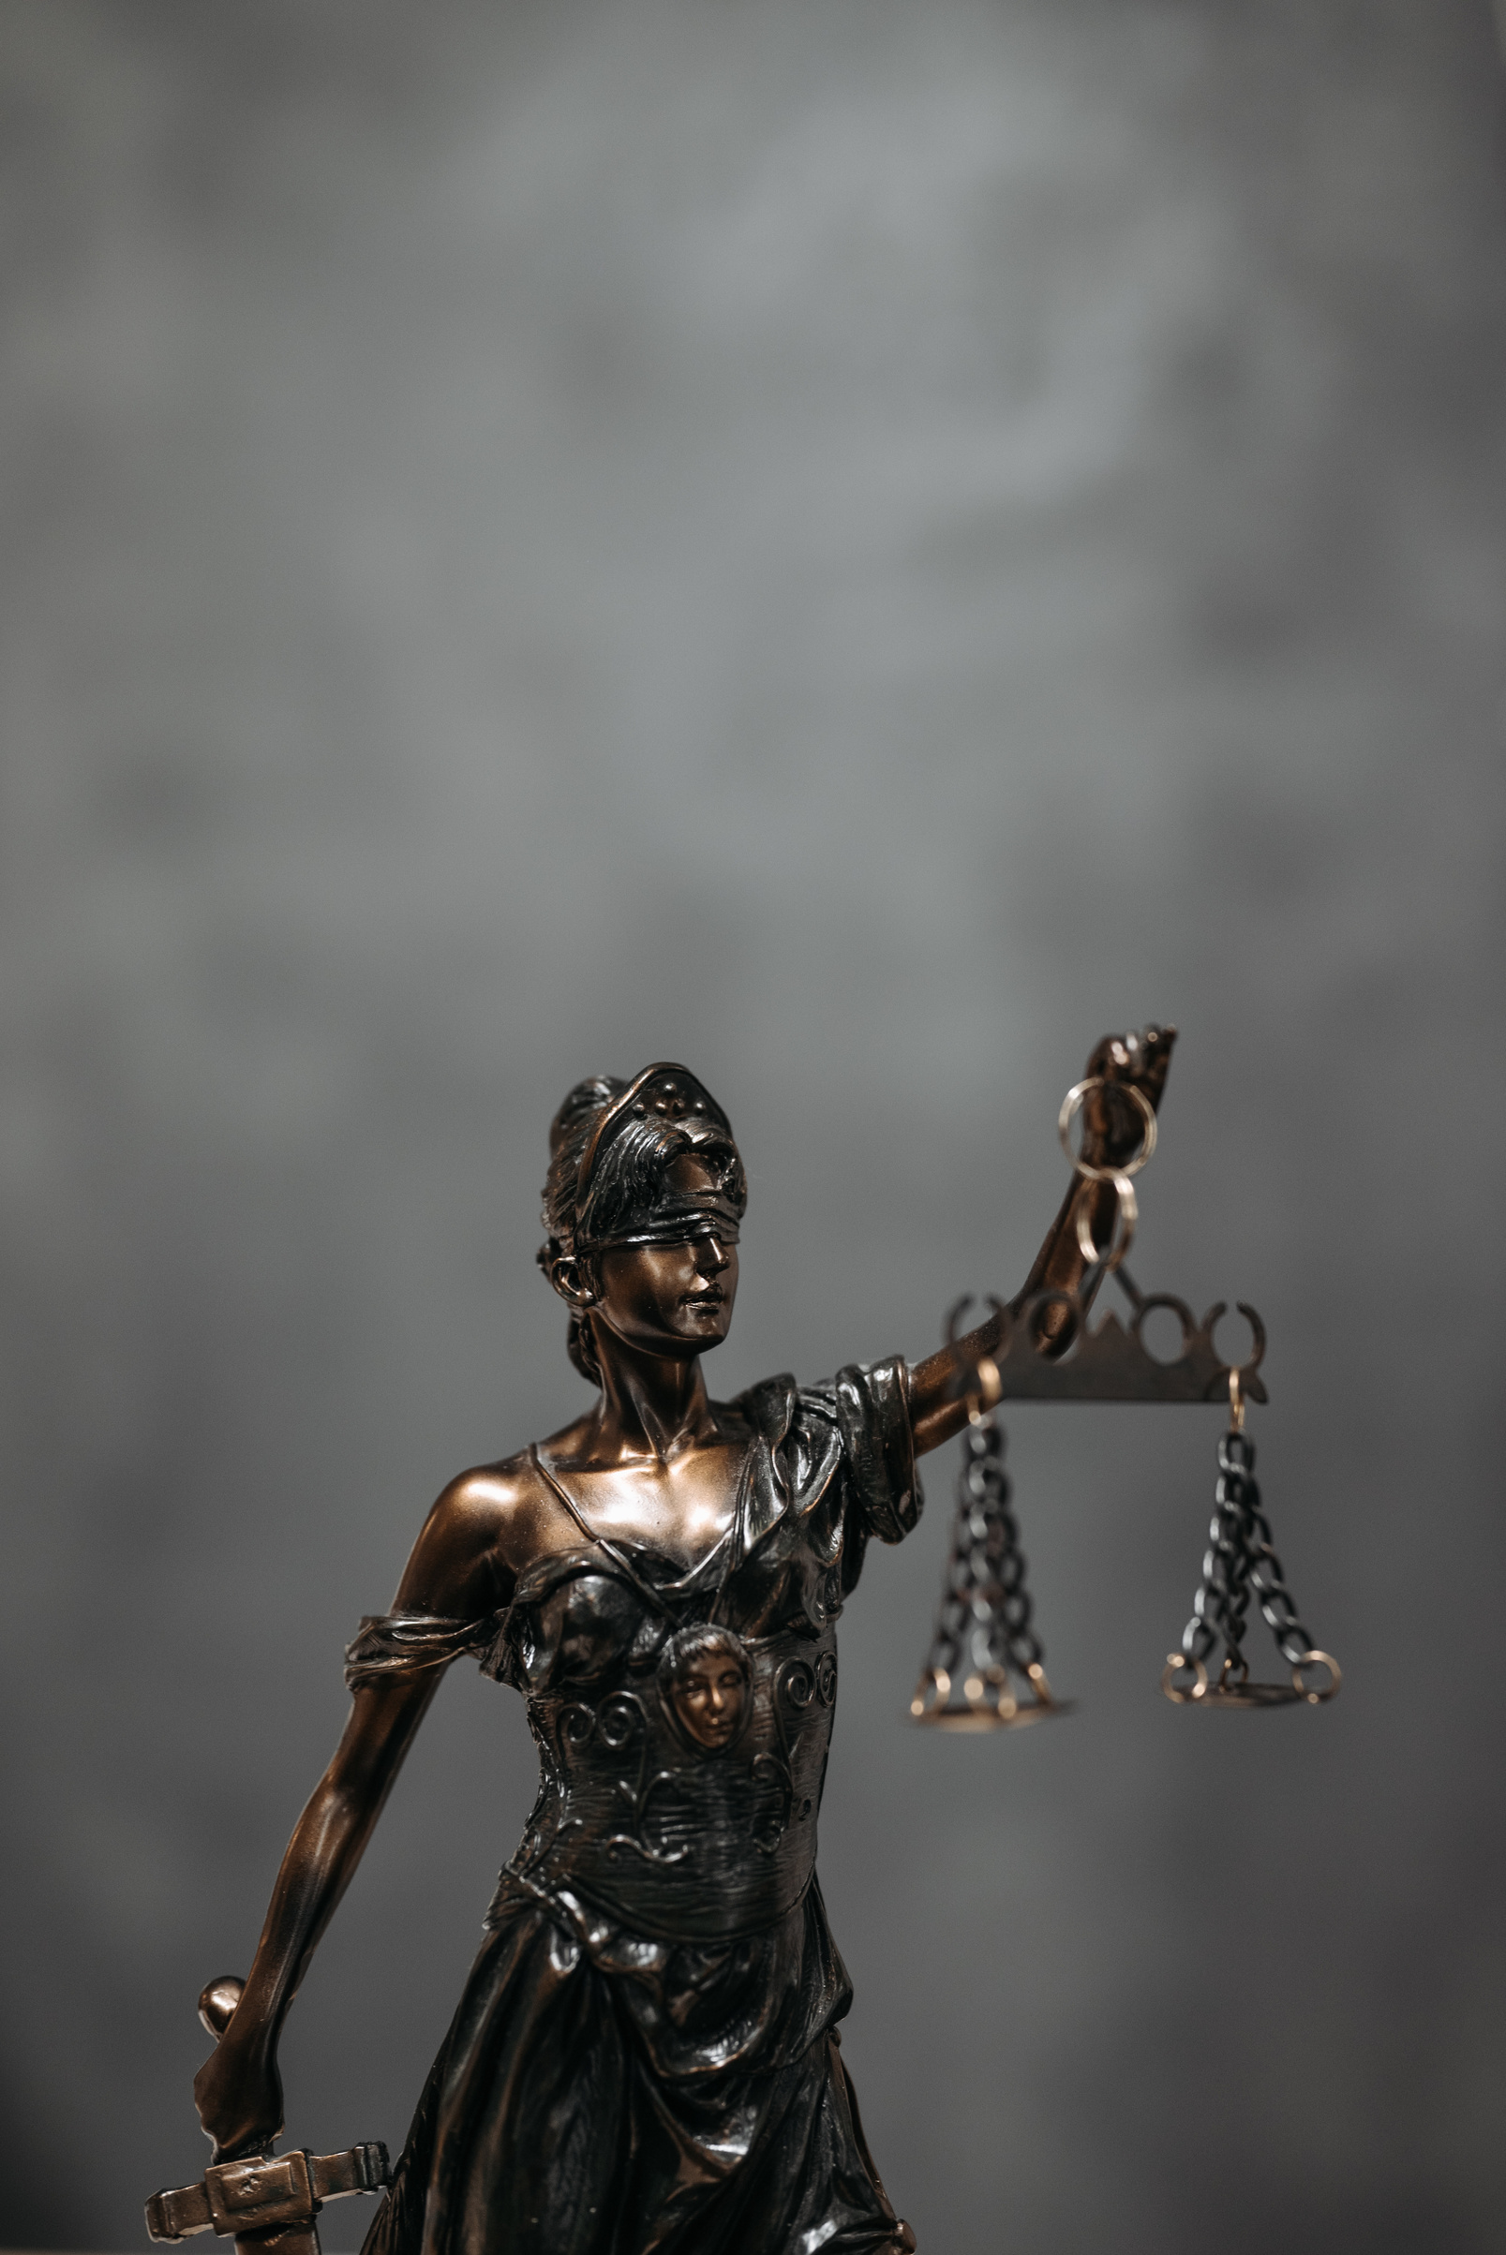

PROBLEM STATEMENT
Case files from the Karnataka High Court are long, complicated, and hard to follow.
Young lawyers struggle to read them and pull out the important points.
Manually reading and summarizing takes a lot of time and energy.
There's no easy way to ask questions or get help while going through the file.
Most files are in English, which can be tough for people more comfortable with other Indian languages.
Without smart tools, case preparation becomes slow and mistakes are easy to make.
This leads to stress, delays, and problems in handling legal work on time.

Slide 3

AGENDA
Problem Statement
What challenges legal professionals face while working with case files.
LLM Integration & Challenges
How Gemini AI was used and what hurdles were faced.
Solution Overview
How LegalEase AI solves those problems using modern AI tools.
Team Contributions
Who did what in the project.
System Design
A simplified flow of how users interact with the app.
Impact
Who benefits from the tool and how it helps them.
Technology Stack
Tools, libraries, and services used to build the solution.
Future Plans
What can be improved or added next.
Approach & Implementation
The steps your team followed and the innovations used

Slide 4
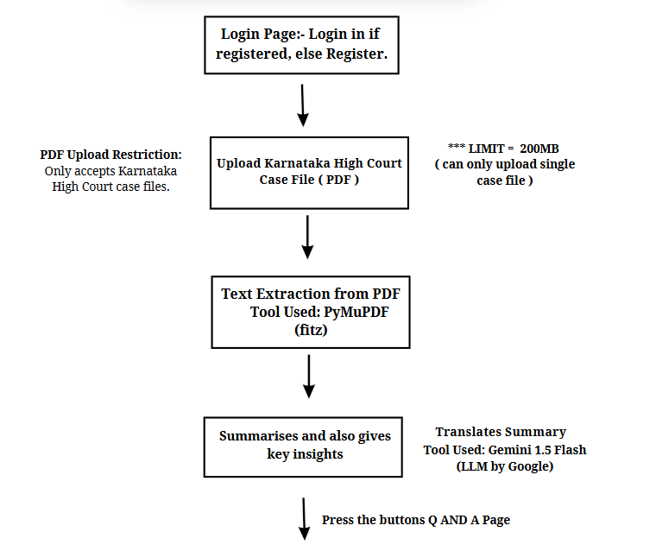
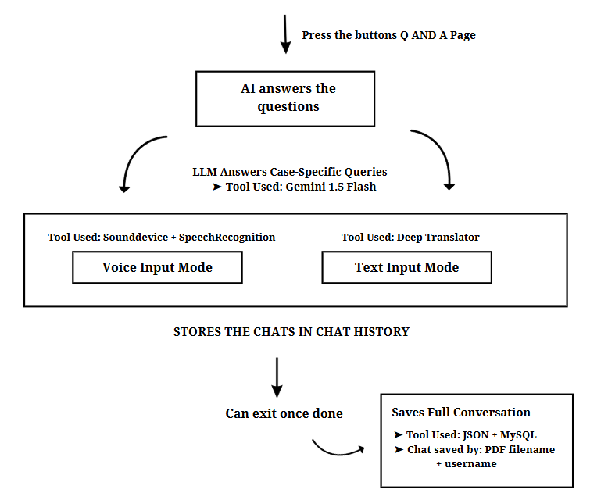
SIMPLIFIED SOLUTION DIAGRAM

Slide 5
Component | Tool/Tech Used | Purpose
LLM (Large Language Model) | Gemini 1.5 Flash by Google | Summarization + Legal Q&A
Speech to Text | Google Speech API + SpeechRecognition | Convert voice to text
Translation | Deep Translator | Multilingual support
UI Framework | Streamlit | Web-based interface
Storage | MySQL + JSON | Chat history & user sessions

Slide 6
HOW WE BUILT LEGALEASE AI
(OUR APPROACH & INNOVATIONS)
Our Approach – Step by Step
Started with the real problem:- Lawyers struggle to read long case files and can't ask questions to the document.
Planned a simple user flow:- Login → Upload case file → Get summary → Ask questions → View past chats
Built one part at a time
Took out text from PDF
Used Gemini AI to explain and answer questions
Added voice input and translation
Stored all chats safely for future use
Tested everything in real situations:- Checked for long files, voice clarity, and whether the AI stays focused on the case.

Slide 7
Each file remembers your chat
Upload the same file again, and your previous chat appears automatically.
You can talk to the case in 23 Indian languages
Ask your question by voice or text in your language—it's smart enough to understand.
AI only answers case-related questions
It won't go off-topic. If the question isn’t about the case, it simply doesn’t answer.
It remembers what you already asked
Your previous questions help the AI give better, more accurate replies.
Safe and private
Everything stays local—no cloud. Chat data is stored securely in your system.
Easy to use
Just upload, ask, and get answers. No complex steps or forms.
What Makes Our Project Special

Slide 8
TECH STACK – TOOLS & TECHNOLOGIES USED
Languages & Frameworks
Python – Main language for backend logic, AI integration, and PDF handling
Streamlit – Used to build the web app interface (simple and fast to develop)
Storage & Database
MySQL – Stores chat history and session data securely
JSON – Saves chat sessions locally per user and PDF file
PDF Processing
PyMuPDF (fitz) – Reads and extracts text from uploaded legal PDFs
Language Translation
Deep Translator – Translates summaries and answers into 23 Indian languages
AI & LLM Integration
Gemini 1.5 Flash (by Google) – Summarizes case files and answers legal questions
User Interface Tools
HTML/CSS (via Streamlit components) – For buttons, layout, and user controls
Base64 + iframe – To preview PDFs within the app
Voice Input
Sounddevice – Records voice in real-time
SpeechRecognition – Converts voice to text using Google’s Speech-to-Text API

Slide 9
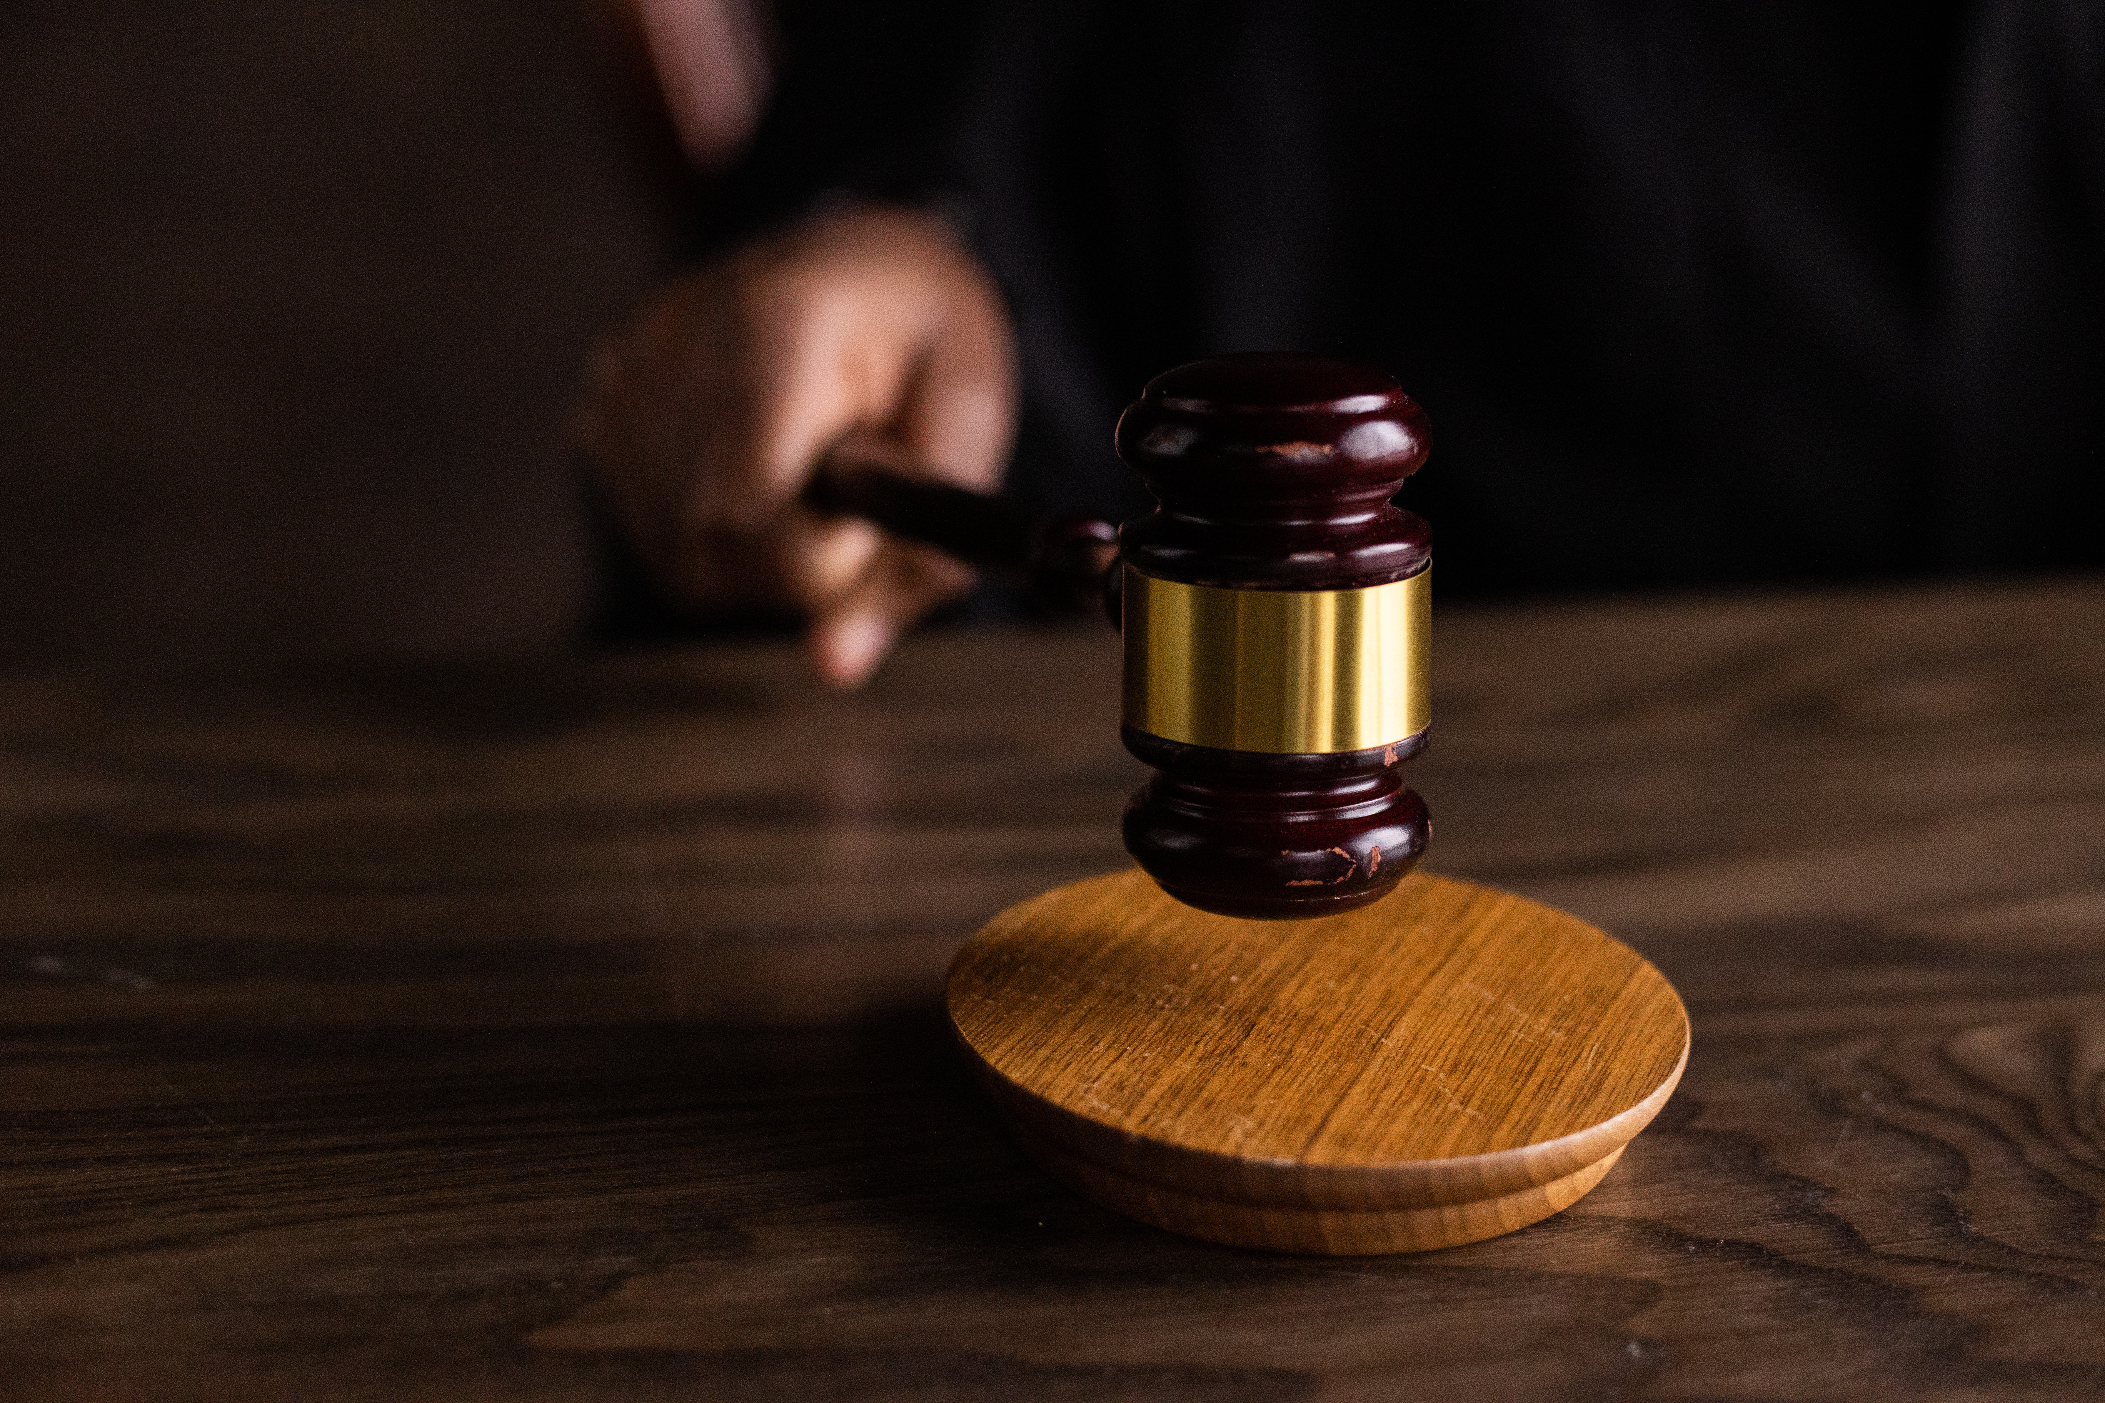
LLM USED, OUR FRAMEWORK & CHALLENGES
LLM Used – Gemini 1.5 Flash (Google)
We used Gemini 1.5 Flash, a fast and powerful Large Language Model from Google.
It helped in:
Summarizing legal PDFs
Answering case-specific legal questions
Handling language translation inputs

Slide 10

3. References
→ We gave Gemini clear instructions to only respond based on the uploaded case and ignore unrelated questions.
“You are a legal assistant for Karnataka High Court civil cases. Only answer questions based on the uploaded case file. Do not guess or give answers unrelated to the file.”
4. Evaluate
→ We checked if Gemini’s answers were:
Based on the actual case file
Legally accurate
Simple and easy to understand
5. Iterate
→ We kept updating the prompts and input structure to improve:
Legal accuracy
Context memory
Voice/text handling
Chat history logic
STEP FRAMEWORK HELPED
1.Task
→ Gemini was told to summarize the uploaded PDF and answer only questions related to that case.
→ Example: It can explain IPC 302 only if it appears in the file.
.
2.Context
→ We added the full case text and previous questions to each prompt so Gemini understood the case and conversation history.

Slide 11
CHALLENGES WE FACED
Context Memory
Gemini sometimes forgot earlier questions. We fixed it by adding past Q&As into each new prompt.
Saving Chat with PDF Names
It was hard to match chats with the correct PDF. We solved it by using the PDF filename to track each session.
Voice-to-Text Accuracy
Voice input didn’t always work well for Indian accents. We added a text option as backup.
Chat History Not Saving
Some chats weren’t stored properly. We fixed bugs in the saving format and logic.
Off-topic Answers from Gemini
The AI sometimes answered questions unrelated to the case. We added strict instructions to stop that.

Slide 12

INDIVIDUAL CONTRIBUTIONS
Kshiti
Raju
Brunda
– Worked on uploading PDFs, voice input, and language translation
– Helped write and organize the report
– Handled the backend using Python and MySQL
– Built the chatbot and chat-saving features
– Helped connect Gemini AI for Q&A
– Improved how the AI gives case-related answers
Bindu
Mujeeb
Jaromi
– Wrote parts of the report and helped formatit
– Checked for grammar, flow, and clear writing
– Planned how the slides should be shown
– Picked the right content to explain the project clearly
– Helped design the PowerPoint slides
– Added screenshots with simple explanations

Slide 13
IMPACT OF THE SOLUTION
WHO BENEFITS?
REAL-WORLD IMPACT
Advocates & Lawyers
Save time by quickly understanding long Karnataka High Court case files.
Saves Time
Summarizes and answers case-related questions instantlyno need to read full files manually.
Law Students & Interns
Learn legal terms, case structure, and reasoning in a simple, interactive way.
Improves Access
Works in 23 Indian languages and supports voice input, making it inclusive.
Law Firms
Use the tool to handle multiple cases faster and reduce manual work.
Reduces Errors
Helps avoid missing important points by highlighting key insights automatically
Citizens Seeking Legal Help
Understand legal documents better, even in their regional language.
Supports Digital Law Practice
Makes legal work faster, smarter, and more efficient through automation.

Slide 14
3. Voice-to-Voice Interaction
Allow users to speak to the chatbot and receive spoken replies instead of only text.
4. Better Security
Implement role-based logins, stronger password protection, and two-factor authentication.
5. Legal Database Integration
Connect to external sites like Indian Kanoon or SCC Online to fetch relevant case references.
6. Mobile App Version
Develop an Android and iOS version so users can access the tool on the go.
7. Support for Other Courts
Expand the platform to include documents from other high courts and the Supreme Court of India.
FUTURE OUTLOOK
1. Similar Case Matching
Use AI to automatically find and suggest related past cases from a legal database.
2. Case Timeline Visualization
Add a timeline to show key events in the case for better understanding and quick navigation.

Slide 15
DEMO LINK:- https://drive.google.com/drive/folders/1Na48TJcHWMr2Ja7aVJopY2_4AkAG5poi
Repository link:- https://github.com/KshitiAnilKumar/LegalEase-AI.git
https://github.com/syed242913/LegalEase-AI.git
https://github.com/Brunda292005/LegalEase-AI.git
https://github.com/RAJU-2005/LegalEase-AI-.git
https://github.com/Bindu834/LegalEase_AI.git
https://github.com/jaromi-joe/LegalEase-AI.git

Slide 16


THANK YOU!
Presented By:- Kshiti, Brunda , Raju , Bindushree, Jaromi , Mujeeb

